Slide 1

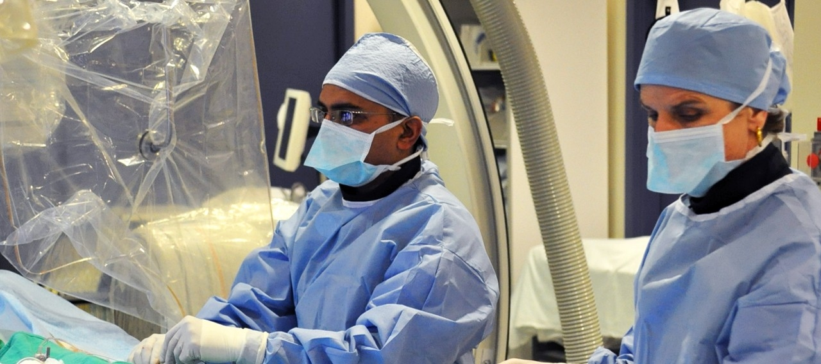
WHAT IS INTERVENTIONAL RADIOLOGY?
A presentation by the Canadian Association for Interventional Radiology (CAIR)
http://www.medicine.dal.ca/departments/department-sites/radiology.html

Slide 2

Real life case
A 50 year old man presents to the emergency department with a history of high speed motor vehicle collision.
CT scan shows a large liver laceration with active bleeding from a hepatic artery branch
You are the ER doctor on shift and you have managed to stabilize his vitals but the patient is still requiring ongoing blood transfusions.
What is the appropriate management?

Slide 3
Real life case
If you said “Surgery”, you would be wrong.
This case will be managed by interventional radiology

Slide 4
Introduction
Interventional Radiology (IR) is a relatively new medical field which performs minimally invasive therapies under imaging guidance.
Interventional radiologists are physicians who perform these minimally invasive treatments.
IR is currently a subspecialty of Radiology: interventional radiologists have completed a diagnostic radiology residency, followed by subspecialty/fellowship training in IR.

Slide 5
What do we do?
Vascular/angiography
Peripheral Vascular Disease
Interventional Oncology
Gastrointestinal, Genitourinary, Hepatobiliary
Women’s health
Biopsies and Drainages
Musculoskeletal
Neurointerventional

Slide 6
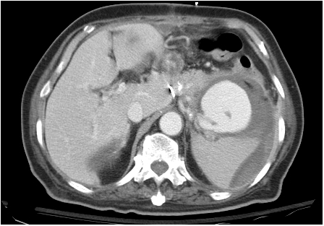
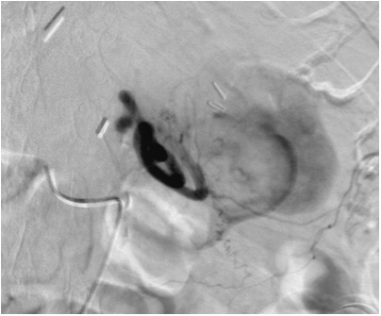
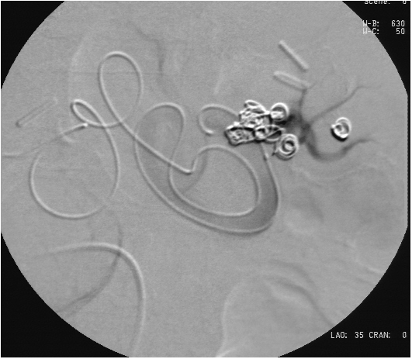
Vascular / Angiography
Coiling of splenic artery pseudoaneurysm
CT scan shows bleeding from a ruptured splenic artery pseudoaneurysm. IR can get to the pseudoaneurysm by threading a wire and catheter through the patient’s arteries from a small incision at the groin, and put some coils at the bleeding site, which stops the bleeding.

Slide 7
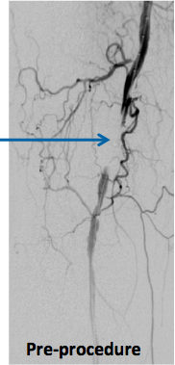
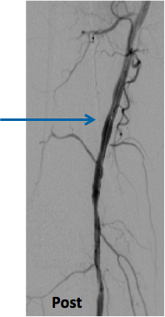
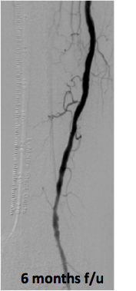
Peripheral Vascular Disease
Angioplasty and stenting of superficial femoral artery
The patient has leg pain when walking, due to severe atherosclerotic disease causing severe narrowing. This narrowing can be opened up with a balloon and then kept open with a stent.

Slide 8
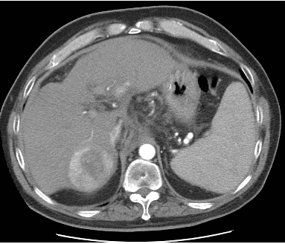
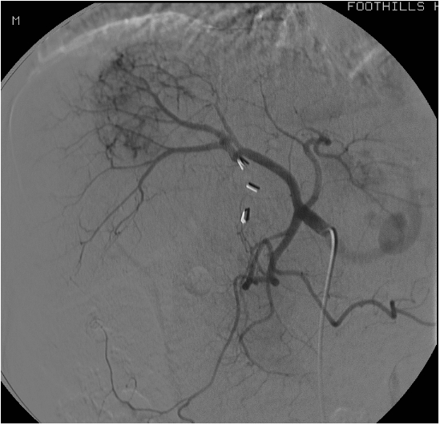
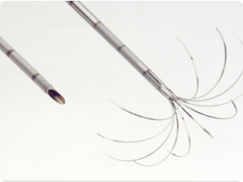
Interventional Oncology
Hepatocellular carcinoma can be treated with
Transarterial Chemoembolization (TACE) or Radiofrequency Ablation (RFA)
This liver tumor can be treated by injecting chemotherapy directly into the tumor via the arteries that are feeding it, or it can be treated by burning it. This is all done via small incisions in the skin – without the need for a laparotomy.

Slide 9
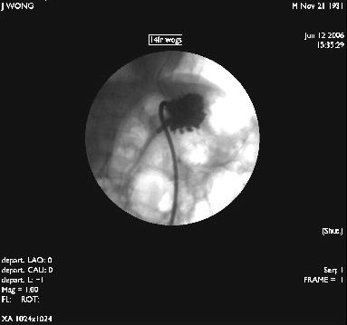
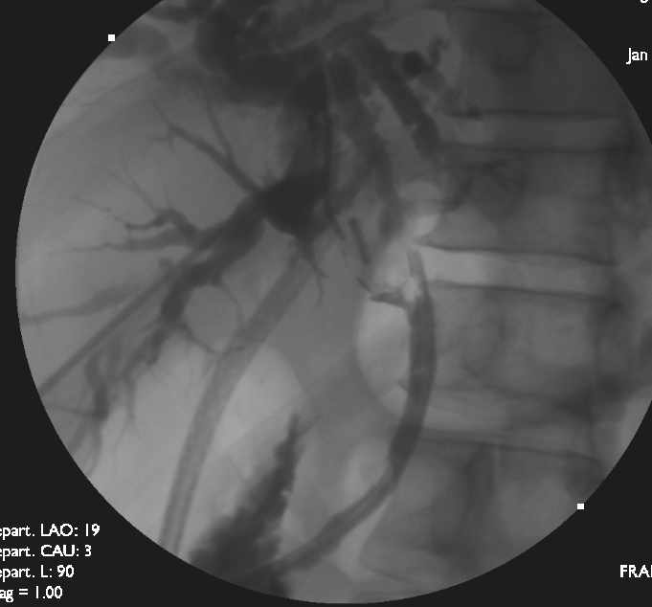
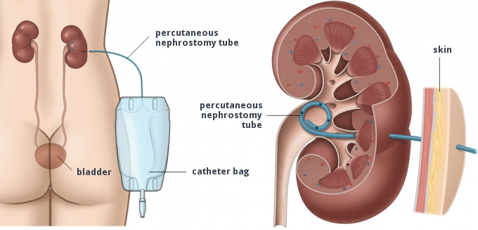
Gastrointestinal, Genitourinary, Hepatobiliary
Percutaneous gastrostomies, nephrostomies, biliary drainages
http://patients.uroweb.org/kidney-ureteral-stones/emergency/
When tubes like bile ducts or ureters get blocked, we can create an alternate pathway for the bile or urine to drain by inserting a drainage catheter via a small incision in the skin. When patients can’t take food orally, we can give them a feeding tube inserted directly through the abdominal wall, giving them a long-term feeding solution.

Slide 10
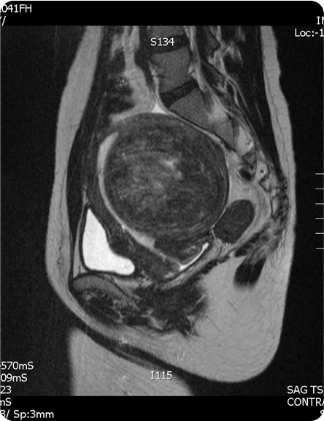
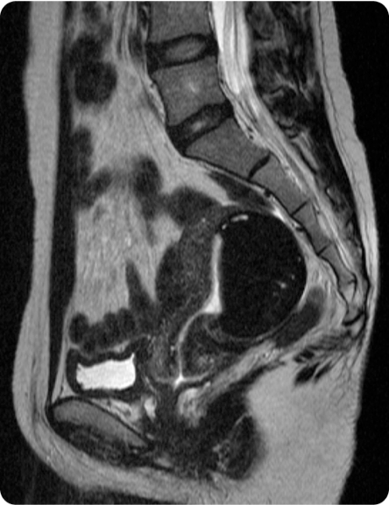
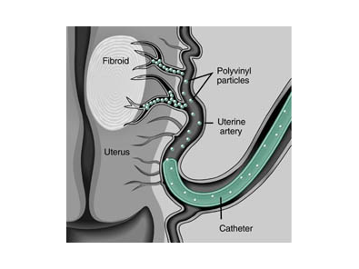
Women’s Health
Uterine fibroid embolization: before and after
Uterine fibroids are benign tumors that cause pelvic pain, bulkiness, and vaginal bleeding. They can be treated by blocking their blood supply from the inside – negating the need for a hysterectomy.

Slide 11
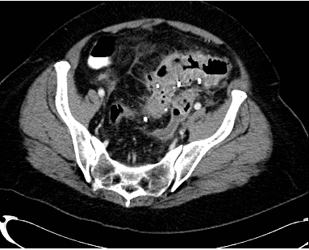
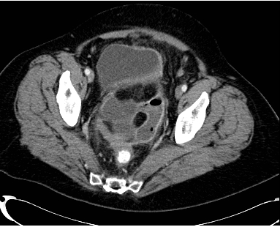
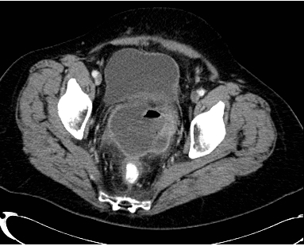
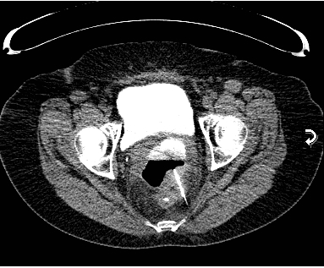
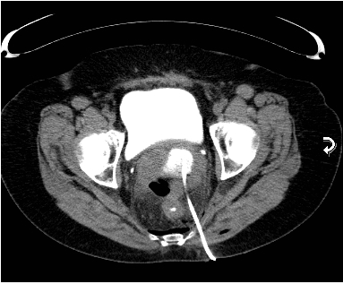
Biopsies and Drainages
Diverticular Abscess Drainage
Many intra-abdominal abscesses which used to require surgery can now be drained by IR via a small incision in the skin for much lower morbidity to the patient and for much less cost.

Slide 12
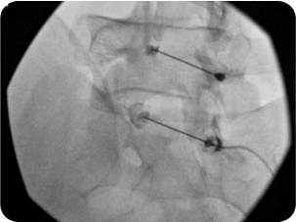
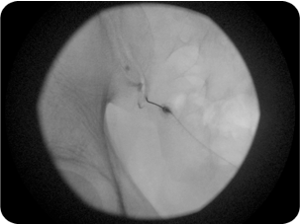
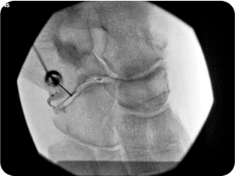
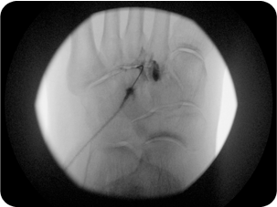
Musculoskeletal
Steroid injections for pain relief
Various joints in the body can develop arthritis and pain. These joints can be injected with steroids to reduce inflammation and give patient relief for up to 6 months or sometimes longer.

Slide 13
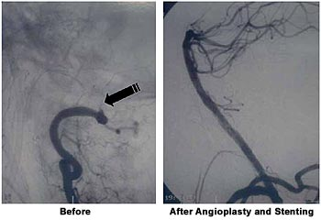
Neurointerventional
Basilar artery occlusion treated with angioplasty and stenting
This patient developed complete occlusion of the basilar artery, resulting in severe neurologic deficits. This occlusion was opened up with balloon and stents, and the patient regained much of his original function.
http://www.cyberounds.com/cmecontent/art141.html?pf=yes

Slide 14
Is IR the right career for me?
Desire to treat patients and improve morbidity/mortality
Prefers performing minimally invasive treatments instead of major surgeries
Strong empathy for patients and interest in patient care
A team player who enjoys working in a multidisciplinary setting
Interest in creative problem-solving and “thinking on the fly”
Preferably also enjoys diagnostic radiology and “solving puzzles” with imaging
Not afraid of longer work hours than diagnostic radiology, but lifestyle is usually still better than surgery

Slide 15
How do I become an interventional radiologist?
Current training pathway:
  Diagnostic Radiology Residency (5 years)
  IR Fellowship (1 year)
Training pathway will be changing soon:
  In the near future, the training pathway will involve increasing the duration of IR training to 1.5 years, and reducing the time spent in DR to 4.5 years), allowing for more training in clinical skills and IR related imaging. Total length of time will stay the same (6 years).
  In the more distant future, IR may become its own specialty and have its own residency program

Slide 16
I’m curious…what now?
GET INVOLVED!
All trainees:
  Find a mentor
  Do research in IR
Medical student:
  Electives in Diagnostic Radiology, Interventional Radiology
  Shadow an interventional radiologist
Resident:
  Core IR rotations + elective IR rotations

Slide 17
Get connected
Websites:
  Canadian Association for Interventional Radiology (CAIR) – www.cairweb.ca
  Society of Interventional Radiology (SIR) - www.sirweb.org
CAIR Annual Meeting
  Medical students welcome, free registration!
  Fellows Day, guest lectures, hands-on demonstrations
CAIR Medical Student Discovery Nights
  Selected cities every year
  Meet and greet with IR staff and residents
  Free food and drinks, hands-on demonstrations

Slide 18
Acknowledgments
Dr. Jason Wong (University of Calgary) for providing many of the images for this presentation.
Dr. Edwin Zhang (University of Alberta) for putting together this presentation.

Slide 19

www.cairweb.ca

